Slide 1
Maximum Flow Minimum Cut

Slide 2
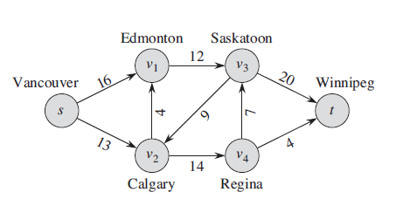
Network Flow
How do we find the maximum flow through a set of pipes/routes from s to t?
Maximum capacity

Slide 3
Network Flow
G = (V, E) : directed graph
Two distinguished nodes: s = source, t = sink
c(e) = capacity of edge e
2
9
5
10
4
15
15
10
source
s
5
3
8
6
10
t
sink
4
6
15
10
capacity
15
4
30
7

Slide 4
Flows
C(u,v): capacity from u to v
f (u,v): flow from u to v
u
f (u,v) /
C (u,v)
v
For all u,v ∈ V f(u,v) ≤ C(u,v)

Slide 5
Find Max Flow: Basic Algorithm
Find a Path from Source to Sink
Depth First (DFS) from Source until we hit Sink
Update the flow along the path
Remove the edges with 0 flow
Continue until there are no more paths from Source to Sink

Slide 6
Problem
Not guaranteed to find maximum flow if we start from the wrong edge
Need provision to retrace our steps

Slide 7
Ford-Fulkerson Algorithm
Guaranteed to find maximum flow if the capacities are rational numbers
The Ford–Fulkerson algorithm (FFA) is a greedy algorithm that computes the maximum flow in a flow network.
It is based on the three important concepts:
The residual network
Augmented path
Cut

Slide 8
Residual Graph
Original edge: e = (u, v) ∈ E
Flow f(e), capacity c(e)
Residual edge
"Undo" flow sent
e = (u, v) and e^{R} = (v, u)
Residual capacity: c(e) – f(e)
Residual graph: G_{f} = (V, E_{f} )
Residual edges with positive residual capacity
Capacity c(e)
u
17 (6)
v
Flow f(e)
residual capacity
u
11
v
6
Reverse flow

Slide 9
Augmented Path
It is a path of edges in the residual graph with unused capacity from source to sink.
Every augmented path has a bottleneck (smallest edge).

Slide 10
Ford-Fulkerson Algorithm
At each iteration, we find an augmented path and increase the flow value.
Terminate the algorithm and return the flow value when no more augmented paths can be found.

Slide 11
Ford-Fulkerson Algorithm
Find a Path from Source to Sink
Depth First from Source until we hit Sink
Update the flow along the path
Add edges in opposite direction for reverse flow (residual edges)
Augments the flow through the residual graph
Continue until there are no paths from Source to Sink
If the maximum outgoing flow from the sink node is equal to the maximum incoming flow of the source node.
The Ford-Fulkerson algorithm works fine and provides the maximum flow of the graph correctly.

Slide 12
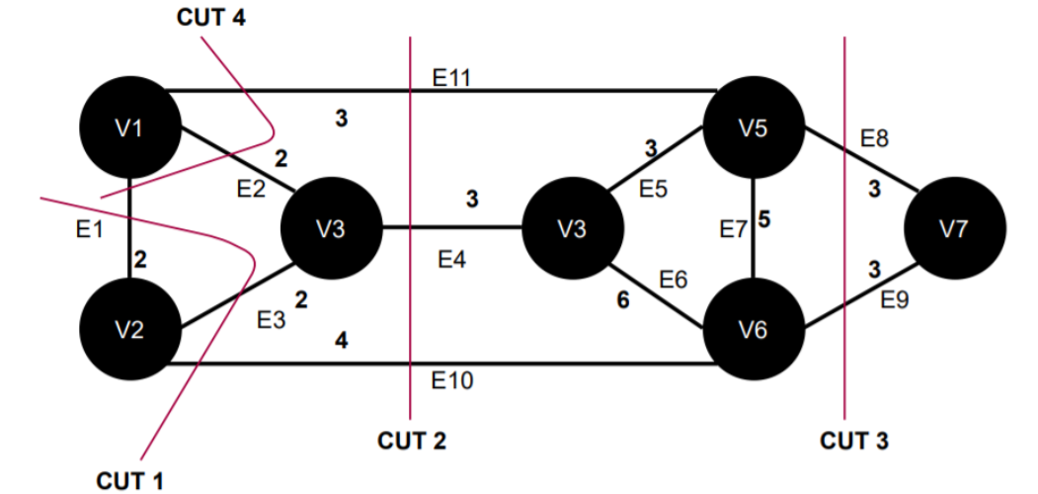
Min-cut
The minimum cut of a weighted graph is defined as the minimum sum of weights of edges that divide the graph into two sets.
CUT 4= 3+2+2 =7
CUT 3= 6 is a minimum cut
CUT 1= 4+2+2 =8
CUT 2= 3+3+4 =10

Slide 13
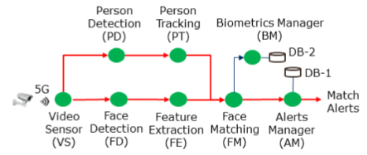
Min-Cut Application
There are many applications of finding the min-cut in network analysis, like:
Weight on each edge is the amount of data transfer
To send some applications to the cloud, we have to partition the graph into two parts.
The goal is minimizing the cost of data transfer: min-cut

Slide 14
Max-Flow Min-Cut Theorem
The maximum flow is equal to the minimum cut
To find the min-cut, run DFS on the final residual graph

